Slide 1
Data Dive 1 Housing
Besada, Iri, Patel

Slide 2
Agenda
Distribution of House Sales Price
Avg Sale Price by Overall Quality and Condition
House Age vs. Sale Price
Bedrooms & Bathrooms vs. Sale Price
Avg Sale Price by Garage Quality
Avg House Prices by Neighborhood
Avg Sale Price by Month/ Year Sold
Conclusion

Slide 3
Distribution of House Sale Prices
Most of the "old" houses are in range of
$100,000 - $400,000
Gradual decrease after mid
$100,000
No record after mid $700,000

Slide 4
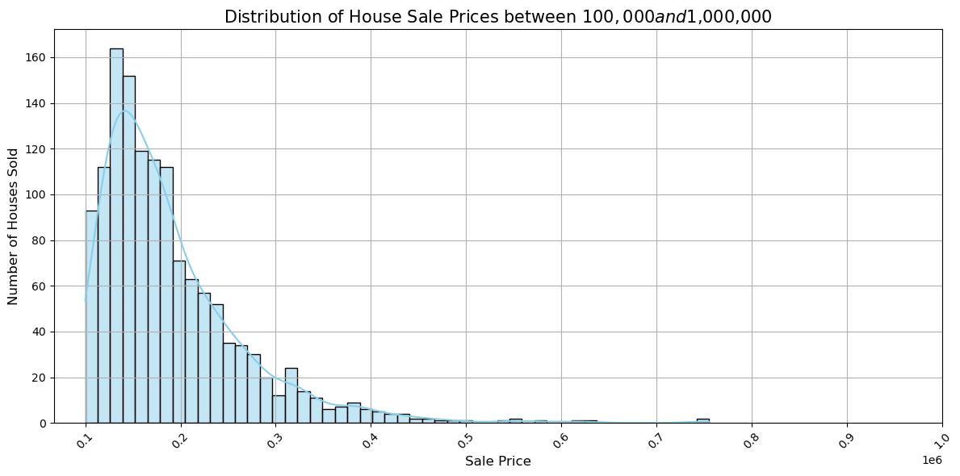

Slide 5
Avg Sale price by overall quality and condition
Mid-quality (5-6) houses are in range of $125,000 - $175,000
High-quality (7-9) houses are in range of $190,000 - $300,000
Positive correlation between quality and condition (e.g., high quality & great condition = higher sale price)

Slide 6
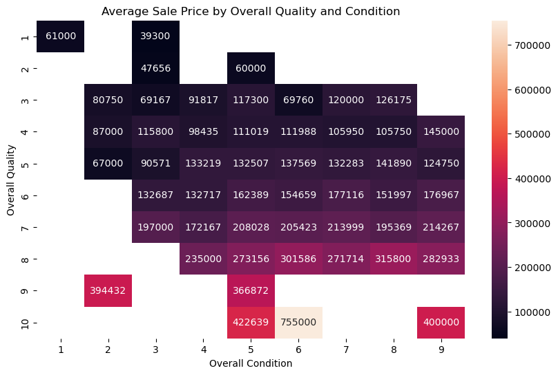

Slide 7
House age vs. sale price
Negative correlation between house age and sale price – older the house, cheaper the price
Most sold houses are below 60 years old
Newer houses have high demand with more various price range (e.g., desirable neighborhood with higher price, vice versa)
Certain older houses are in high demand due to historical significance or unique architecture, etc.

Slide 8
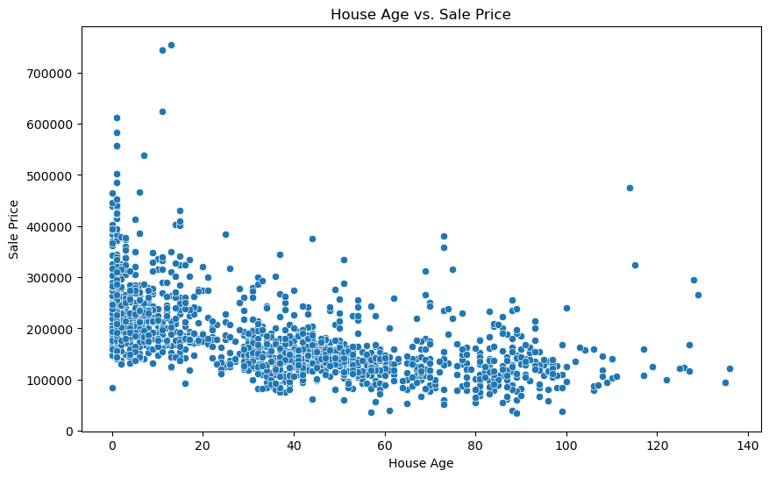

Slide 9
Bedrooms & bathrooms vs. Sale price
Bedrooms
Starting price after 3 bedrooms continually increase
Multiple bedrooms are in high demand for various family sizes
Bathrooms
Starting price after 2 bathrooms continually increase
En-suite bathrooms can be an additional factor for higher sale price

Slide 10
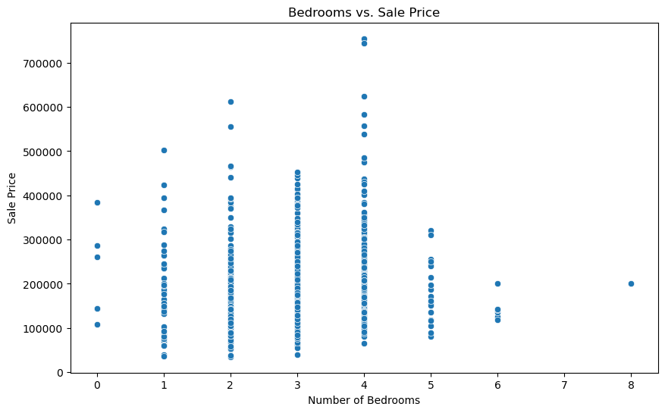
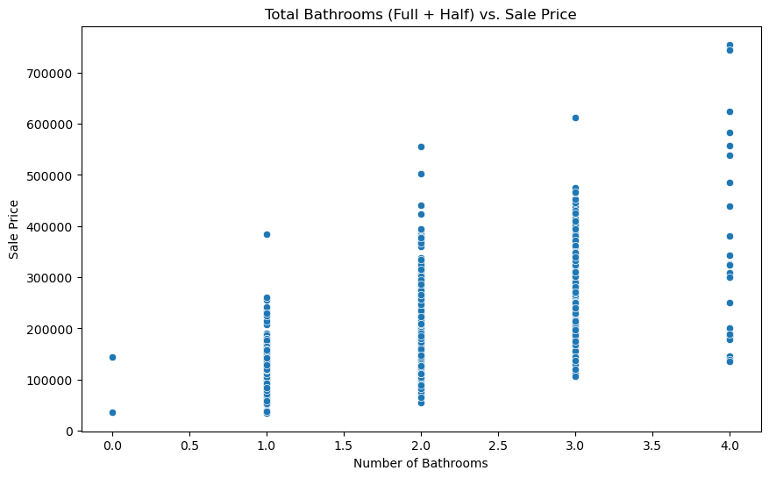

Slide 11
Avg Sale price by Garage quality
Better the quality of garage, sale prices increased
“Excellent” garages can be assumed to be high-quality with more space, built-in storage, and interiors
High-quality garages can be highlighted when houses are marketed

Slide 12
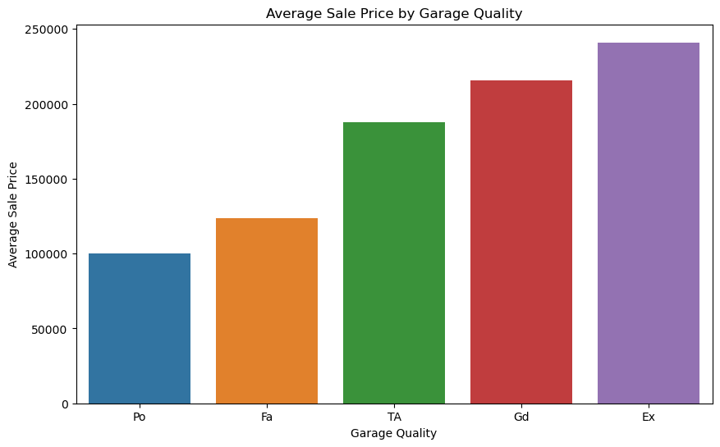

Slide 13
Avg House prices by neighborhood
Neighborhoods strongly affect the house prices
Higher prices can be due to safety/ low crime rates, school zoning, etc. of the neighborhoods

Slide 14
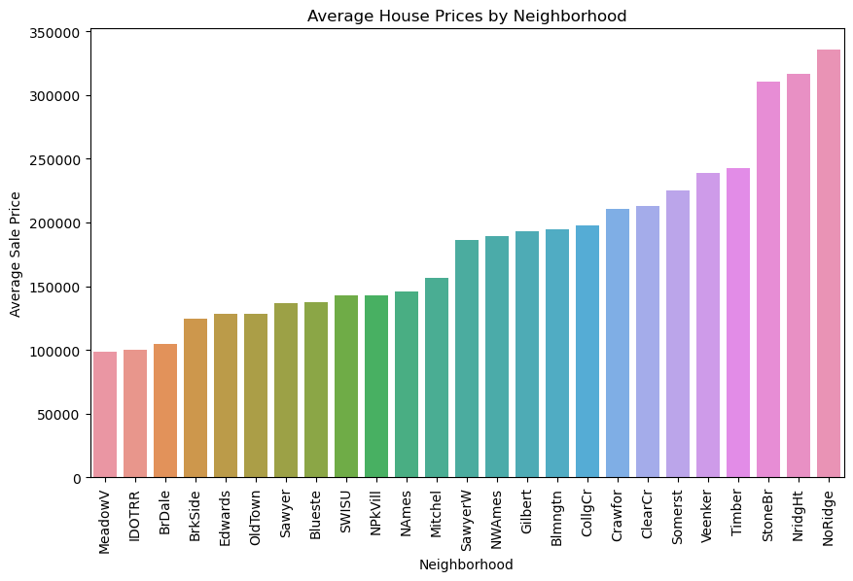

Slide 15
Avg sale price by month/ year sold
Month
September has the highest avg sale price
April has the lowest avg sale price
Year
In 2007, houses were sold the highest avg due to real estate bubble
End of 2007, sale price dropped dramatically because of the house market crash

Slide 16
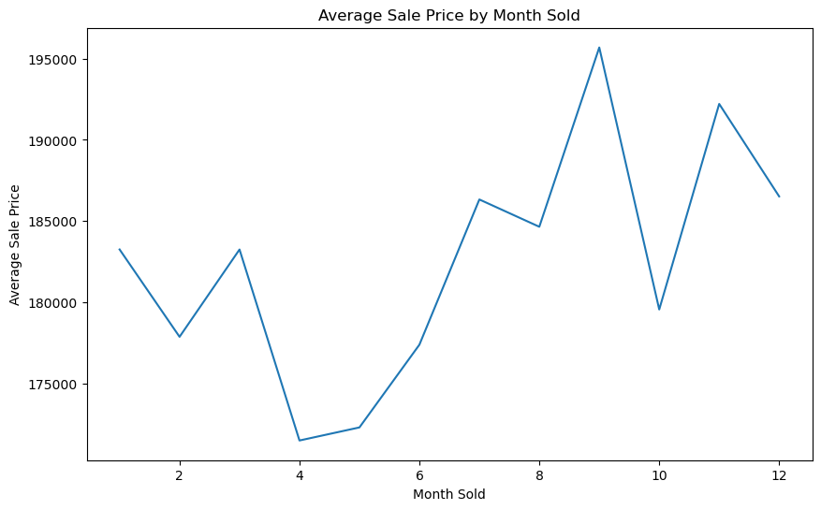
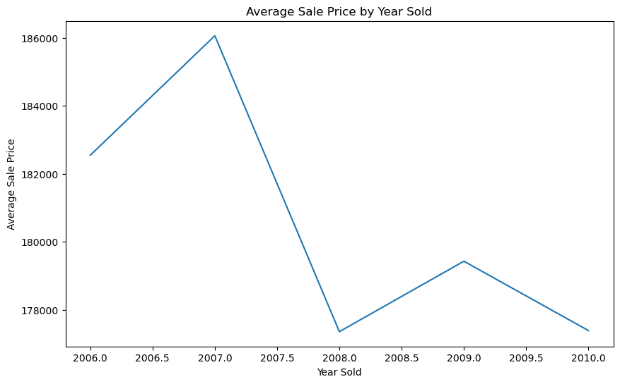

Slide 17
Conclusion
As a real estate agent, it is important to consider all the factors that can affect the prices to provide houses in buyer’s budget range.
Most Influential Factors
Quality & Condition: Higher quality and condition leads to higher prices
Number of Rooms: Houses with more rooms can be sold for higher prices, and more with features like en-suite bathrooms
Neighborhood: Location is a crucial factor to be considered and an agent should be recommending within the buyers’ needs and budget

Slide 18
Conclusion
Listed factors can be used to tailor pricing strategies to each buyers
Utilize these findings to meet the demands of various clients will ultimately lead to increased sales and client satisfaction

Slide 19
Works cited
Home Prices, Explained: Location, Location, Location (castlecookemortgage.com)
The 2008 Housing Crisis - Center for American Progress

Slide 20
THANK YOU

